Slide 1
Virtual Reality Driving Tutor Simulation
Student: Cian Gardiner
Project Supervisor: Dr Bryan Duggan
Second Reader: Edina Hatunic-Webster

Slide 2
Project Description
The aim of this project was to create an
eLearning application which enables the user
to learn how to drive.

Slide 3
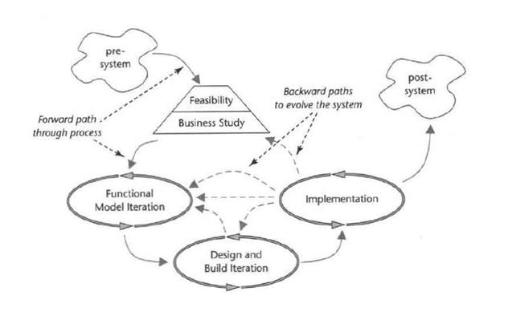
Software Methodology
Dynamics Systems Development Method (DSDM).
Notes:
Type of agile software development method.
Project can change at any time.
Timeboxing.
Allocation of resources including time.
The user is active in the creation of the application by testing it throughout the development lifecycle.

Slide 4
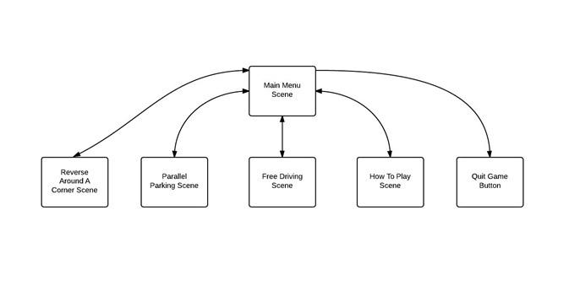
Design
Game Layout
Notes:
Shows relationships between the scenes.
Can travel between all scenes by going back to the main menu.
Quit Game is the only action which cannot go back to the main menu.

Slide 5
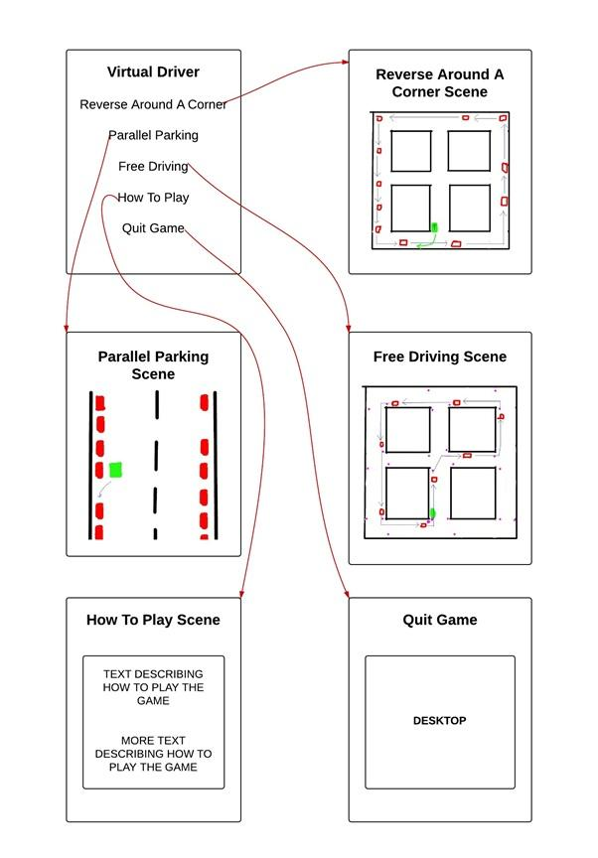
Design
Horizontal Prototype

Slide 6
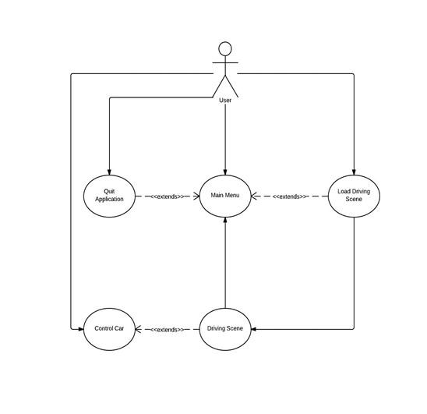
Design
Driving
Use Case
Diagram

Slide 7

Development
C# Scripts in Unity

Slide 8
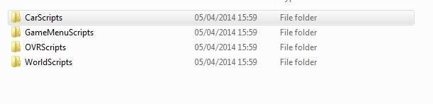
Development
Scripts
Notes:
Scripts for different types of cars, static cars, automatic cars and the player car.
Scripts to interact with the game menu.
Did not create any of the OculusVR scripts, did tweak certain values to suit my needs.
WorldScripts which included my WorldLoader script and TrafficLightManager scripts
Talk about WorldLoader...

Slide 9
Development
Third Party Development
Oculus Scripts
Shifting Gears
Textures
Notes:
I changed certain values within the Oculus Scripts to allow me to build my Rift Camera game object. Far clip plane, setting values needed for lens correction.
Textures for the buildings and the roads I got online.
Shifting gears I got from the Unity forums, somebody posted a solution when the question was asked.
I coded everythingelse, worldscripts, carscripts and game menu scripts

Slide 10

Development
Reversing around a corner
Parallel Parking
Observation (Free Driving)
Notes:
What went well…
Driving Instructor gave good advice on what I should put into the application, three most problematic areas.

Slide 11
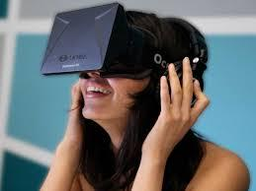
Development
Achieved a realistic
driving experience
Notes:
Really great, the rift worked perfectly in fooling your mind into thinking you are driving a car!

Slide 12

Development
What should be
implemented?
Notes:
Didn’t know what to implement, there was so much I could have done!
So many rules of the roads. Really had to cut my project down and
try and achieve the basics!

Slide 13

Development
Time Management
Notes:
DIdn’t account for the Christmas exams,
Development work should have started earlier to
see that I needed to change my project from the start.

Slide 14
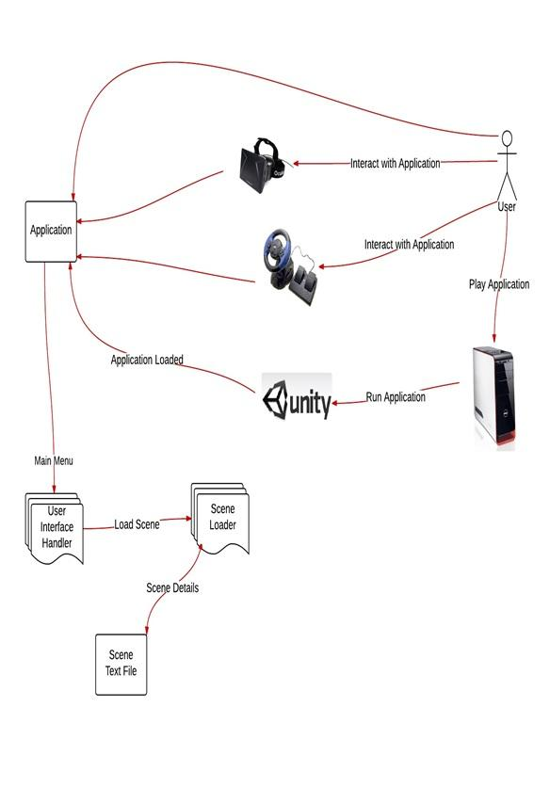
System Architecture
Notes:
Can explain this by looking at the picture.

Slide 15

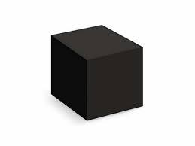
Testing
White Box Testing
Black Box Testing
Notes:
Tested each piece of code before it was put into the final version or the version that I was going to be submitting.
Black box testing tested the system as a whole when I was finished the application to make sure
that it is working.

Slide 16


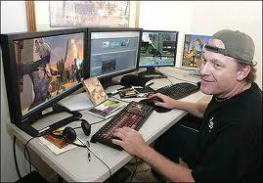
Testing
Notes:
I got student in college, drivers and non-drivers to test the application as well as game industry professionals.
Once they tested it I got them to fill out a survey which gave general feedback about the application

Slide 17


Evaluation
User had too much freedom!
Application needs more functionality...
Notes:
My evaluation the user had too much freedom, they were having a great time crashing into things.
User evaluation the application needs more functionality.

Slide 18
Reflections & Conclusions
Developed a driving simulator using Unity.
The project was too ambitious.
Improved self learning and time management skills.
Notes:
Too ambitious, too many things which could have gone in, the workload was too mcuh.

Slide 19
Future Work
Add different driving environments.
Implement strict rules and tasks which the user must follow.
Add functionality to allow an instructor to add objects to scene at runtime.

Slide 20

Questions

